Slide 1
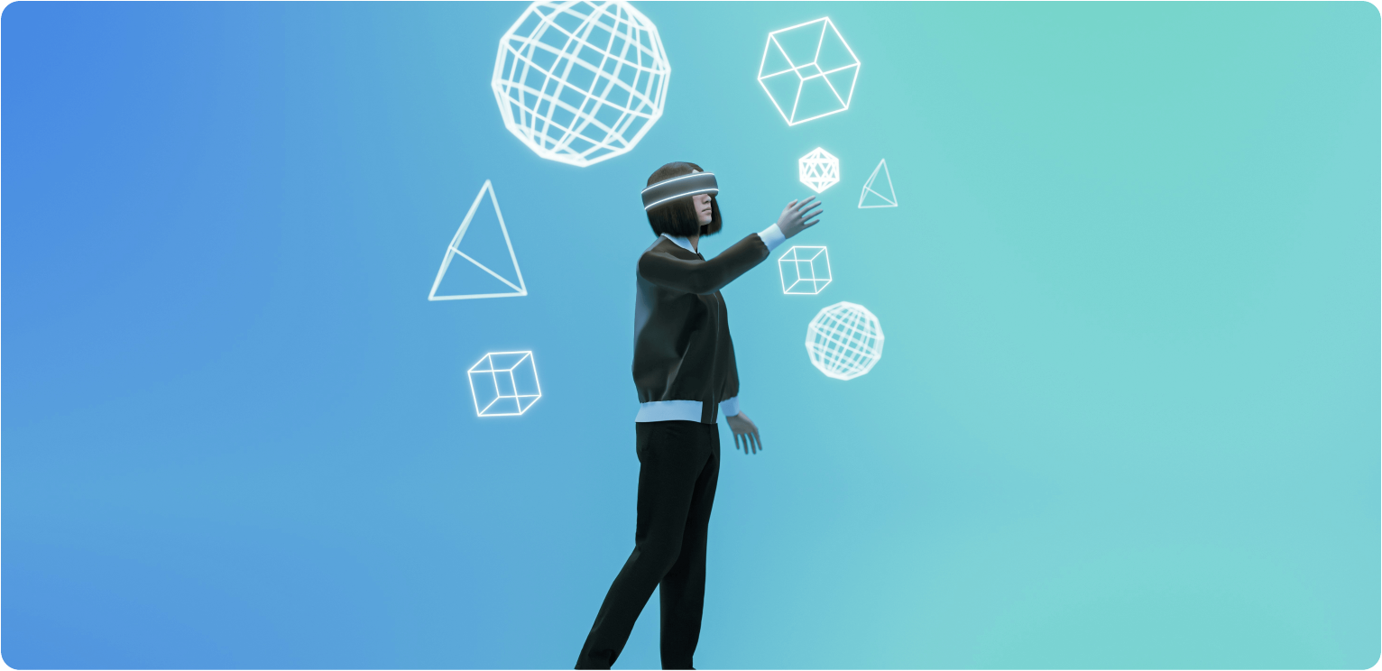
Introduction to
Computer
PIYUSH

Slide 2
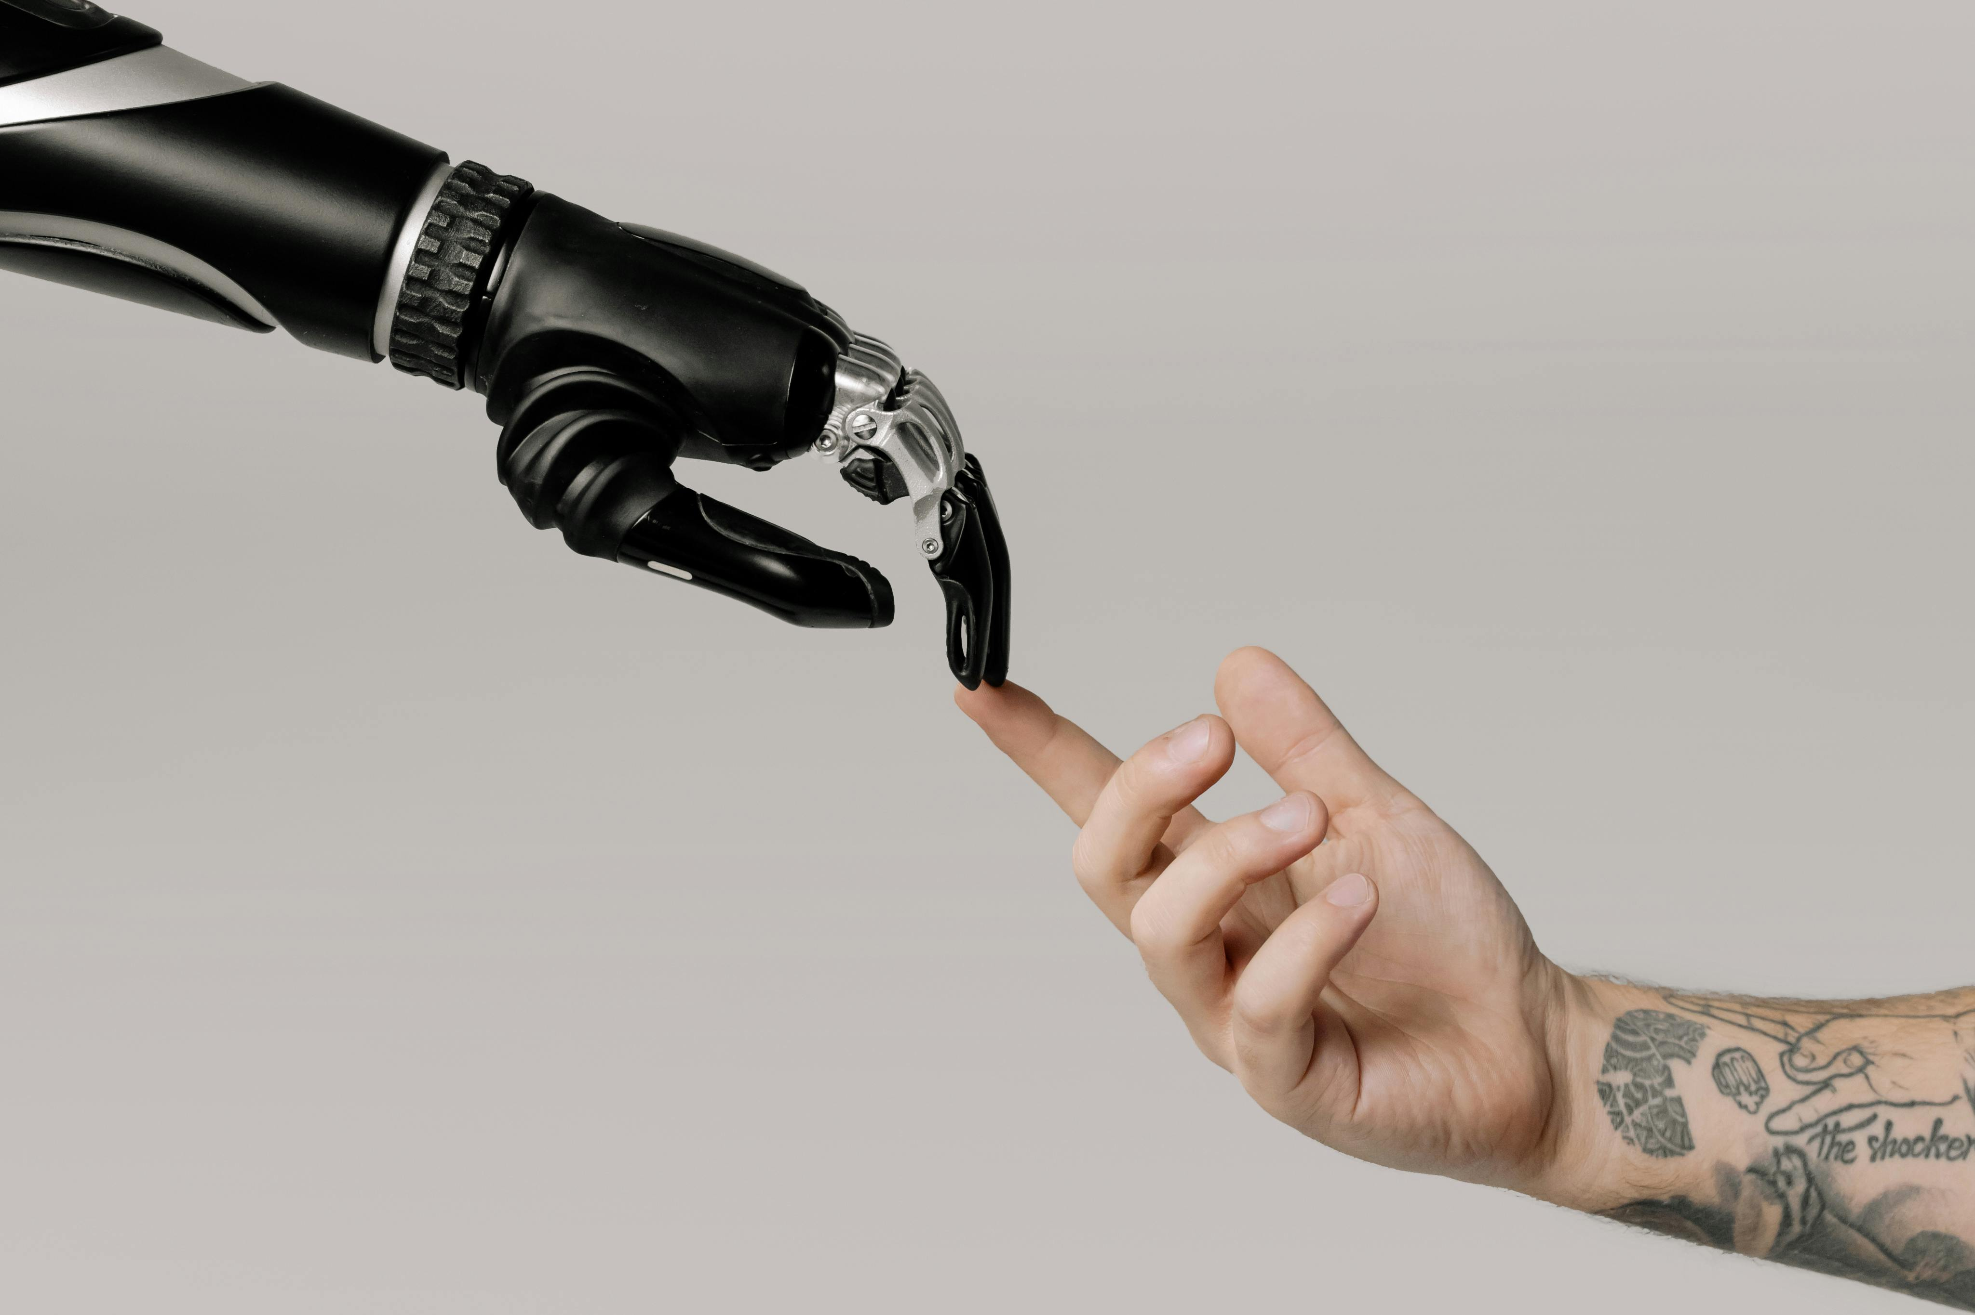
01 What is a Computer?
02 History of Computers
02 History of Computers
03 Components of a Computer
03 Components of a Computer
04 Types of Computers
CONTENTS
04 Types of Computers
05 Computer Networks
05 Computer Networks
06 Computer Applications
06 Computer Applications
07 Challenges and
Considerations

Slide 3

What is a Computer?

Slide 4
Definition of a Computer
A computer is an electronic device that processes data, executing instructions to perform various tasks.
It consists of hardware and software components, enabling users to create, manipulate, and store information efficiently and reliably.

Slide 5

Characteristics of Computers
Types of Computers
Computers are extremely fast and accurate in performing tasks.
They can store large amounts of data and work continuously
without getting tired, showing great diligence.
They are versatile, capable of performing different types of tasks,
and can handle multiple operations at the same time.
Computers also support automation and
make communication and data sharing easy and efficient.
Supercomputer – Fastest, used for scientific research.
Mainframe – Powerful, supports many users (banks, govt).
Minicomputer – Mid-sized, used in small businesses.
Microcomputer – Personal use (PCs, laptops, tablets).
Workstation – High-performance for professionals.
Server – Provides services to other computers.
Embedded Computer – Built into devices (TVs, cars, etc.).

Slide 6
How Computers Work?
A computer works in a cycle: Input → Process → Storage → Output.
Input: You enter data using devices like a keyboard, mouse, or mic.
Processing: The CPU (Central Processing Unit) processes the data. It's the brain of the computer.
Memory:
RAM holds data temporarily while tasks are running.
Storage (like SSD or HDD) keeps data permanently.
Output: Processed data is shown using output devices like a monitor or printer.
Software: Instructions (programs) that tell the hardware what to do.

Slide 7
Components of a Computer

Slide 8
Hardware Components
Central Processing Unit (CPU)
The Central Processing Unit (CPU) is the brain of the computer, responsible for executing instructions and processing data. It consists of
the Arithmetic Logic Unit (ALU), Control Unit (CU), and registers, enabling efficient data manipulation and control within the system.
Memory (RAM and Storage)
Input and Output Devices
Input devices, such as keyboards and mice, allow users to
interact with the computer by entering data. Output devices,
like monitors and printers, present processed information to users.
Together, they facilitate communication between the user and the
computer system, enhancing functionality and user experience.

Slide 9
Software Components
System Software
System software is essential for managing hardware and software resources. It includes the operating system, which provides a user interface and controls system
operations, as well as utility programs that enhance system performance and security. Together, they ensure effective and efficient computer functionality.
Application Software
Application software refers to programs designed for end-users to perform specific tasks such as word processing, spreadsheet management, or graphic design.
It enhances productivity by providing tools for various functions, from creating documents to managing data and facilitating communication.
Examples include Microsoft Office and Adobe Creative Suite.
Programming Languages
Programming languages are essential software components that enable users to communicate instructions to a computer. They can be categorized
into low-level languages, like assembly, which are machine-readable, and high-level languages, like Python or Java, which are more abstract and
user-friendly, facilitating software development and problem-solving.

Slide 10
Types of Computers

Slide 11
Classification of Computers
Personal Computers
Personal computers (PCs) are versatile machines designed for individual use. They come in various forms, including desktops, laptops, and tablets. PCs are
widely used for tasks such as browsing the internet, word processing, gaming, and multimedia consumption, making them essential in daily life.
Laptops and Notebooks
Laptops and notebooks are portable computers designed for mobility and convenience. While laptops typically Feature more power and larger screens, notebooks prioritize lightweight design and battery efficiency, making them ideal for everyday tasks and travel. Both offer varying performance to meet diverse user needs.
Servers and Mainframes
Servers are powerful machines designed to manage network resources and shared services, ensuring reliability and performance for multiple users. Mainframes are large, high-performance computers used for critical applications, processing vast amounts of data simultaneously, primarily in industries such as banking and healthcare.

Slide 12
Emerging Technologies
Tablets and Smartphones
Tablets and smartphones exemplify the convergence of computing and mobile technology. Their portability, touch interfaces, and extensive app ecosystems empower users with versatile functionalities, making them essential tools for productivity, communication, and entertainment in today's tech-driven landscape.
Supercomputers
Supercomputers are advanced computing systems capable of processing vast amounts of data at incredible speeds. They are utilized in complex simulations, scientific research, and large-scale data analysis, driving innovation in fields such as climate modeling, molecular research, and artificial intelligence.
Quantum Computers
Quantum computers leverage the principles of quantum mechanics to process information at unprecedented speeds. They utilize qubits, allowing for complex calculations and problem-solving capabilities beyond the reach of classical computers, making them pivotal for advancements in emerging technologies such as cryptography and materials science.

Slide 13
Computer Networks

Slide 14
What is a Computer Network?
A computer network is a system of interconnected devices that communicate and share resources. Its purpose is to enable data exchange, enhance efficiency, and facilitate collaboration among users, ultimately improving productivity and access to information across various locations.
Types of Networks
A computer network is a collection of interconnected devices that communicate and share resources. The main types of networks include Local Area Networks (LANs), Wide Area Networks (WANs), Metropolitan Area Networks (MANs), and Personal Area Networks (PANs), each serving different geographical scopes and connectivity needs.
Network Topologies
A computer network is a collection of interconnected devices that communicate and share resources. Network topologies describe how these devices are arranged: star, bus, and ring are common types, each offering distinct advantages in terms of scalability, reliability, and performance.

Slide 15
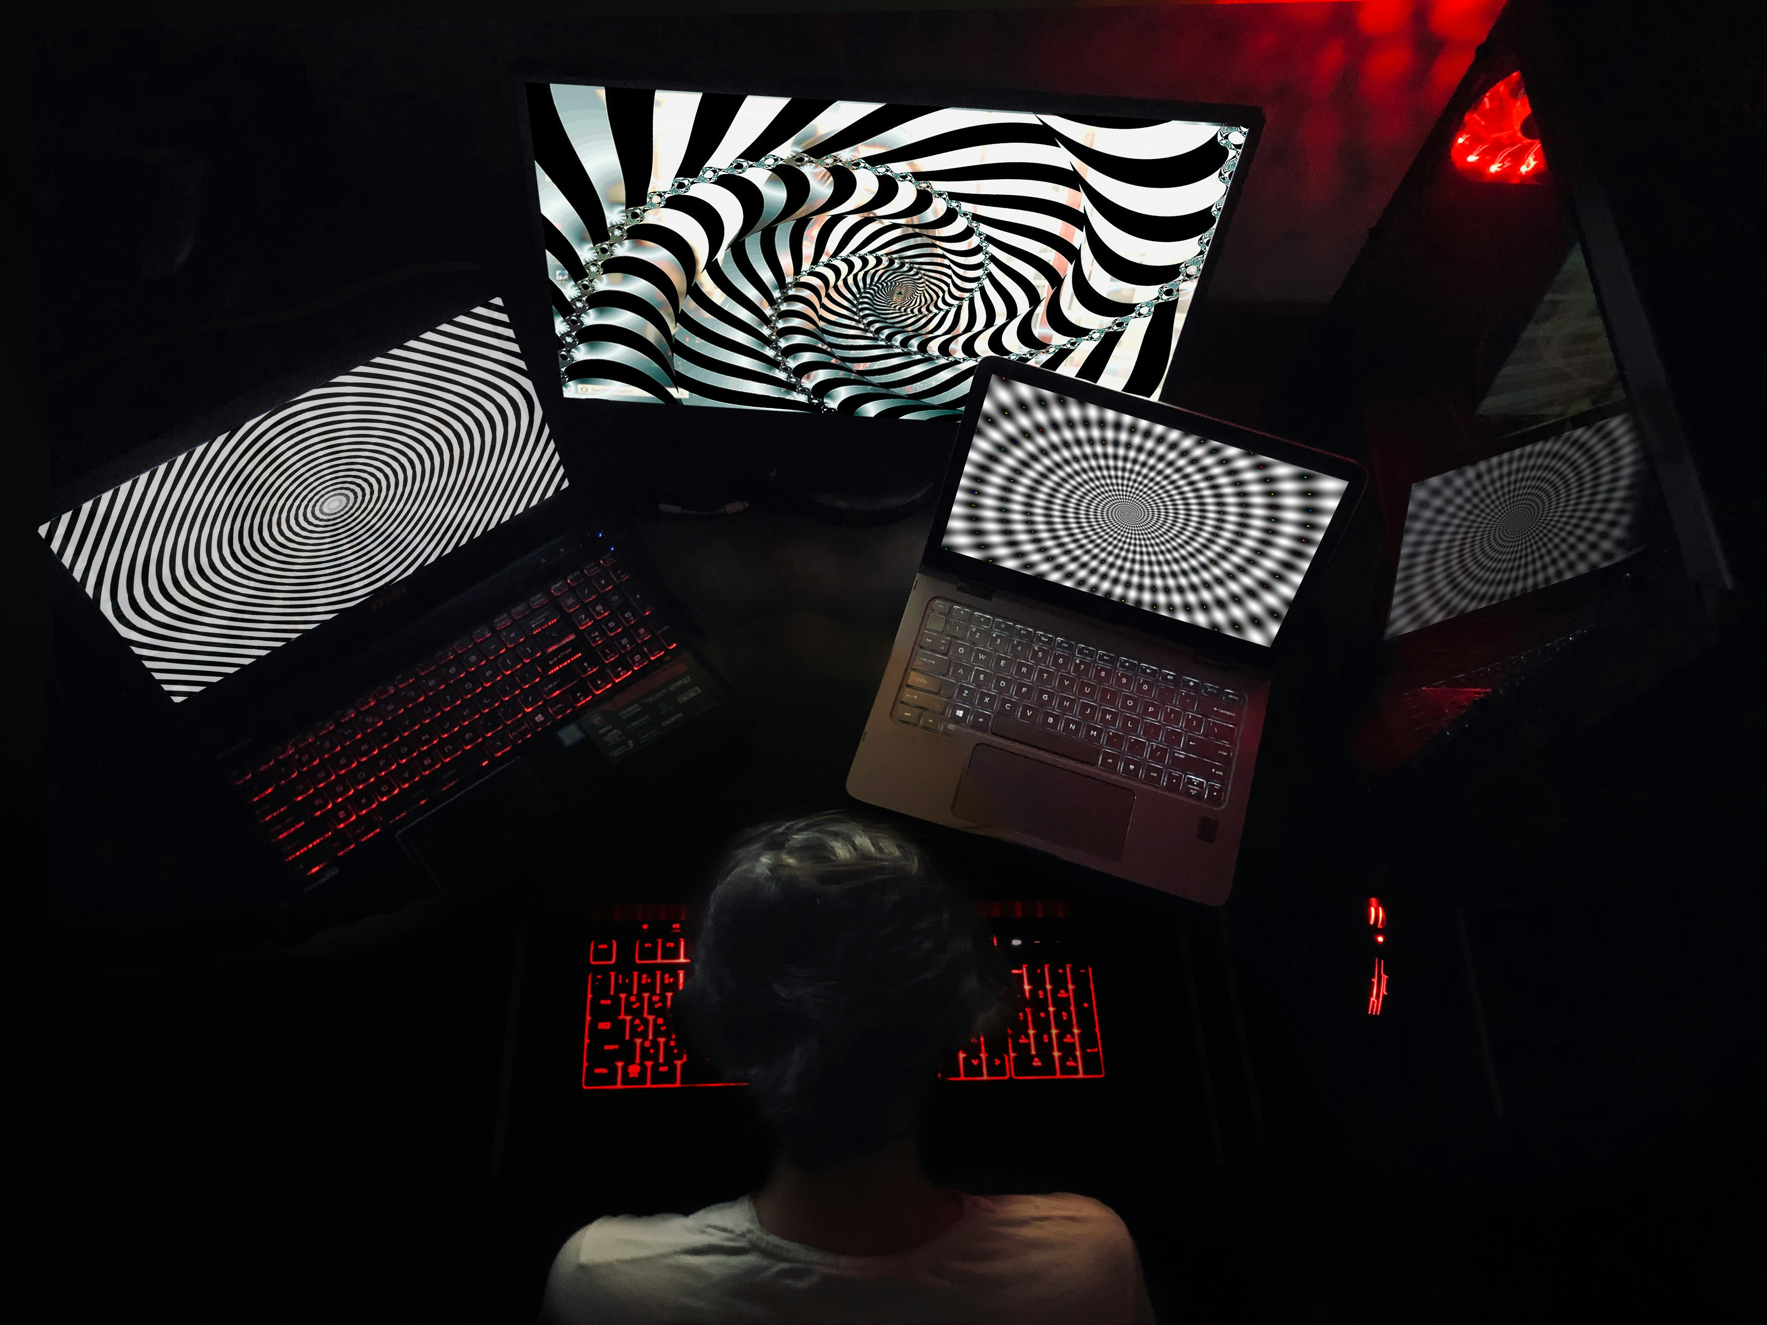
Challenge and consideration of computer

Slide 16
Considerations:
Compatibility: The computer and printer must be compatible in terms of drivers and operating systems.
Connectivity: Stable connections (USB, Wi-Fi, or Bluetooth) are essential for smooth functioning.
Software Support: Proper printer software or apps are required for advanced features like scanning, duplex printing, and ink level monitoring.
User Knowledge: Basic computer knowledge is needed to operate printer settings and troubleshoot errors.
Challenges:
Driver Issues: Missing or outdated drivers can prevent printing or cause poor-quality output.
Network Problems: In shared or wireless printers, network errors can disrupt printing tasks.
Security Risks: Networked printers can be entry points for cyber-attacks if not properly secured.
Maintenance Alerts: Sometimes, computers fail to show real-time printer alerts (like low ink), leading to failed prints.

Slide 17
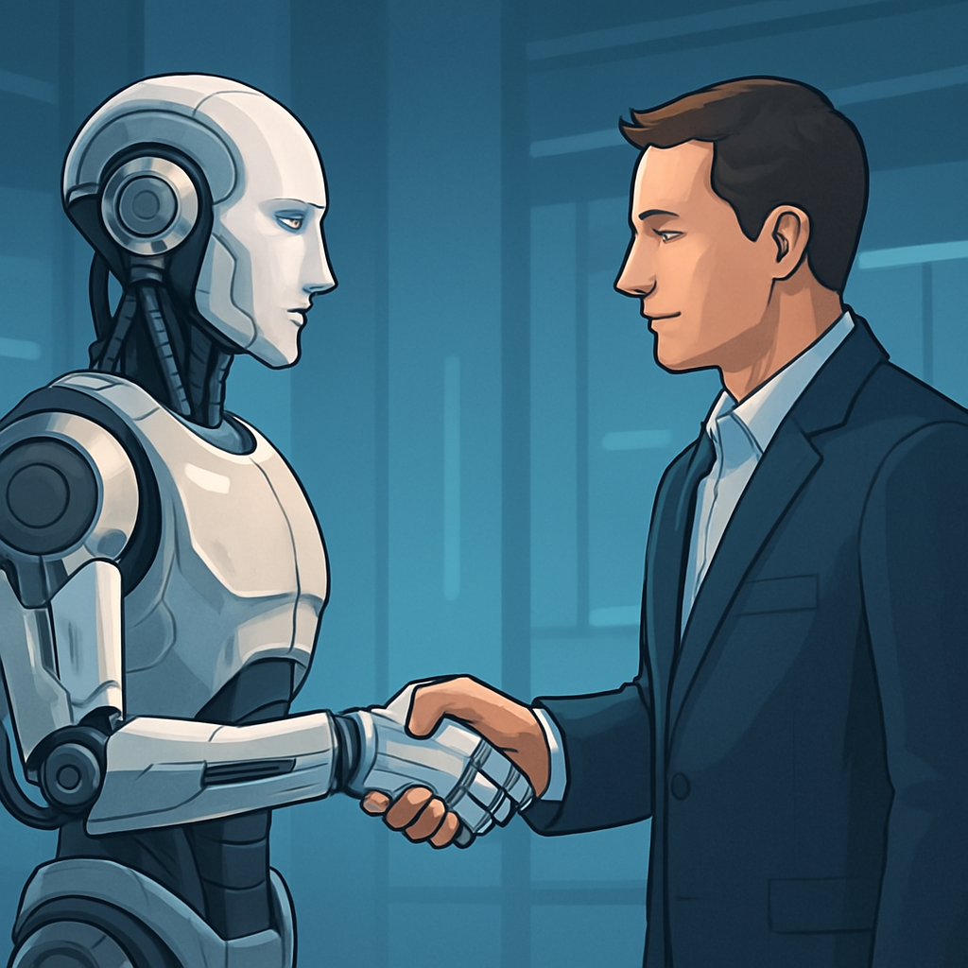
Thanks
Presenter: PIYUSH

